Slide 1

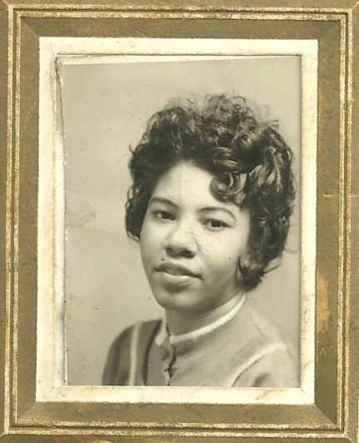
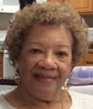
Velma Mae’s 78th Birthday Celebration
September 10th, 1940
Notes:
Seventy-eight years ago on Sept 10th, 1940, Velma Mae Strange was born,, the youngest child of Floyd and Beatrice Strange.

Slide 2
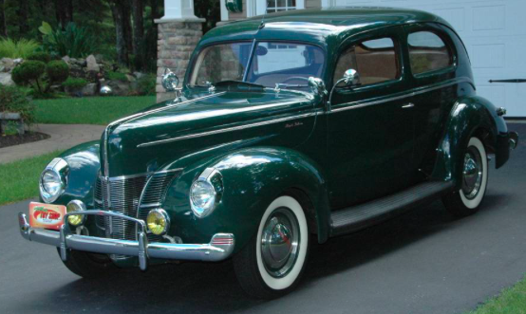
Notes:
The average price for a new car was $850. Speaking of cars, Velma Mae’s brother, Clarence, taught her how to drive. Unlike conventional wisdom would have it, he advised her to drive fast or not at all!

Slide 3

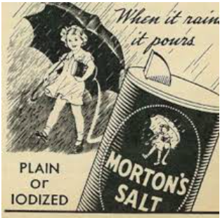
Notes:
Morton salt was introduced, which is a good thing since this is one of Velma Mae’s favorite spice, second only to hot sauce!

Slide 4
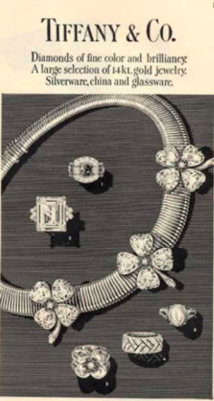
Notes:
Tiffany’s in New York City was the first fully air-conditioned store. And you all know how much Velma Mae enjoys shopping, especially when she’s hunting for sales.

Slide 5
Notes:
In 1940 Franklin D. Roosevelt was president.

Slide 6
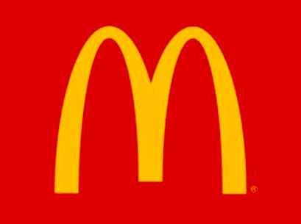
Notes:
McDonald’s was founded in 1940. Now Velma Mae loved those strawberry milkshakes back when they still used real strawberries.

Slide 7
Notes:
And one of the most popular songs of 1940 was “Concerto for Cootie.”

Slide 8
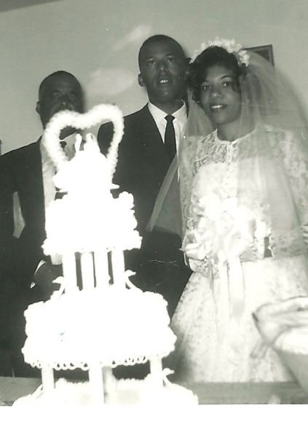
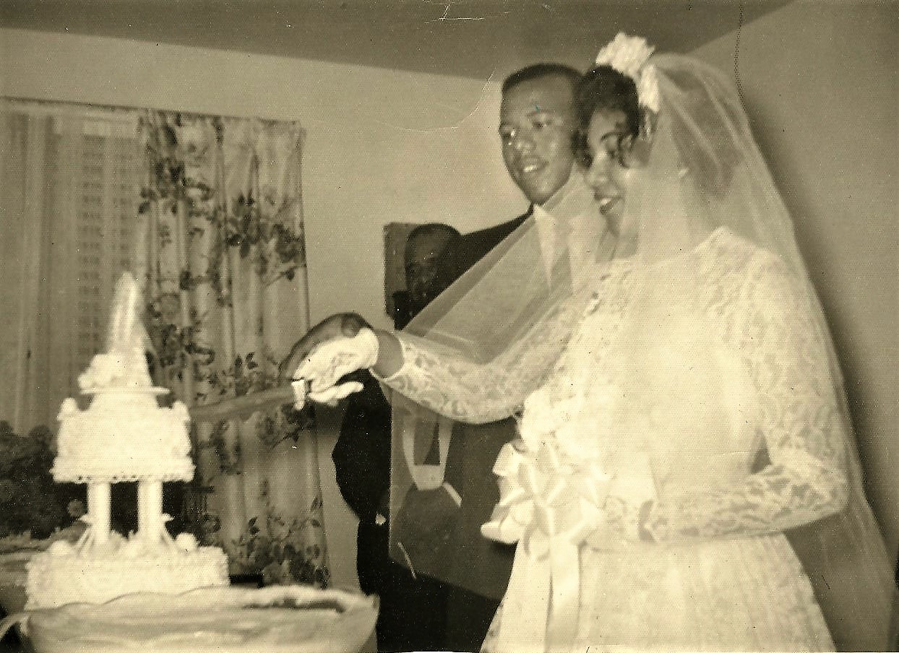
Notes:
On August 12, 1961, Velma Mae Strange married Karl Wayne Roberson.

Slide 9
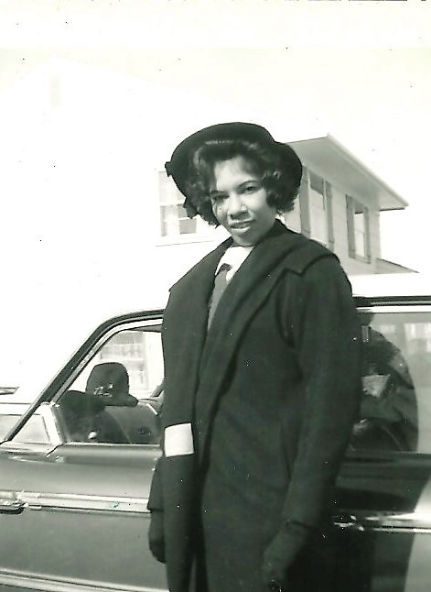
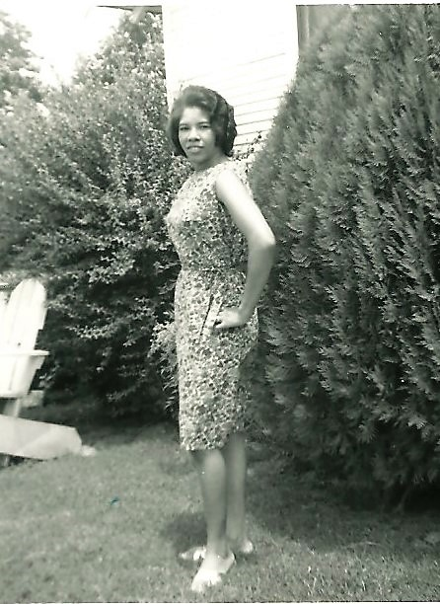
Notes:
Velma Mae used to cut a dashing figure until…

Slide 10
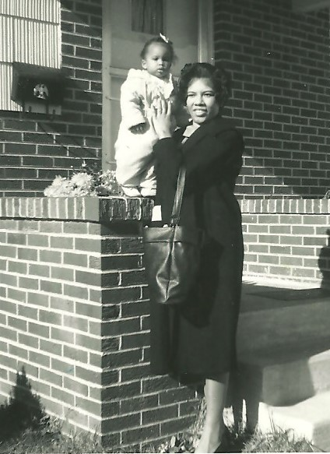
Notes:
She birthed Etzetta Renee. Then 18 months later…

Slide 11

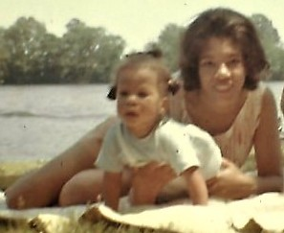
Notes:
Carla Mae arrived! Now they thought she would be a boy, so they had not picked out a girl’s name. A nurse insisted that Velma Mae and Karl Wayne name baby Roberson; so she received his first name and her middle name. And the third girl in the family was…

Slide 12
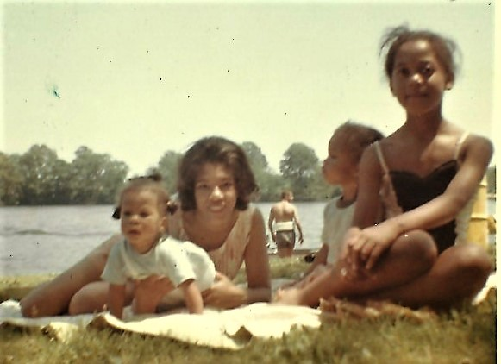
Notes:
Roventa! Karl Wayne’s youngest sister. Now when’s the last time you’ve seen Roventa in a bathing suit?

Slide 13
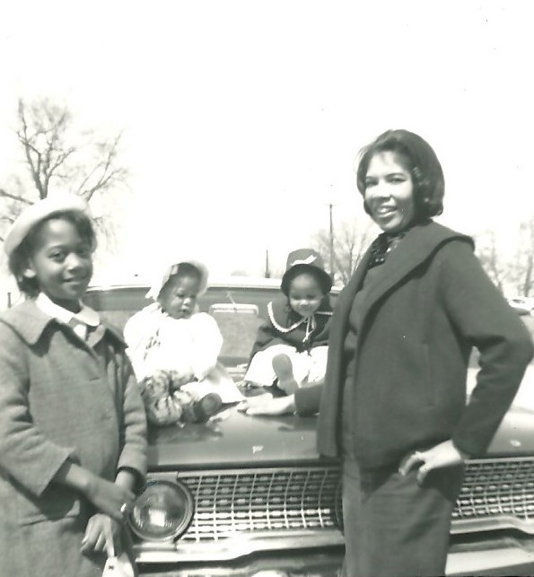
Notes:
Here she is again in her winter coat. Then years later...

Slide 14
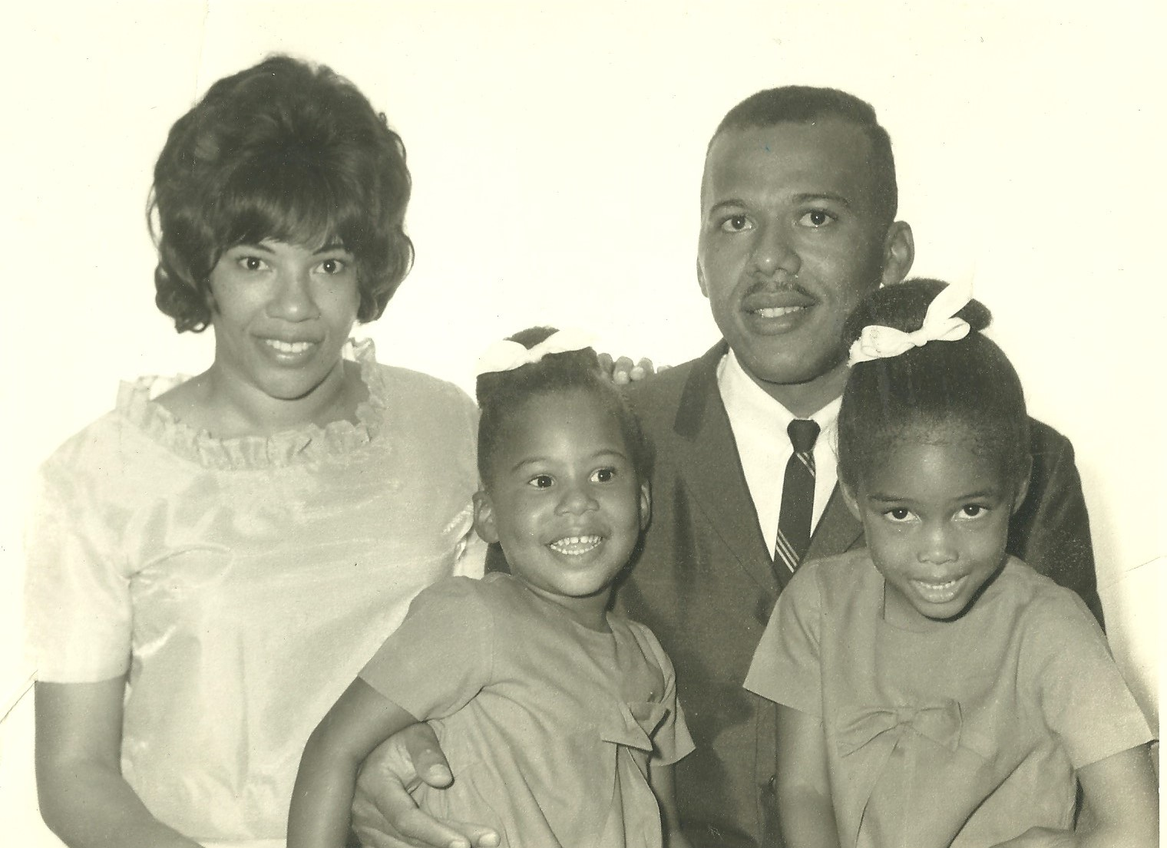
Notes:
Velma Mae’s family grew in age but not yet in number. Nowadays conventional wisdom says you shouldn’t be outnumbered by your children, but Velma Mae didn’t know about that back then.

Slide 15
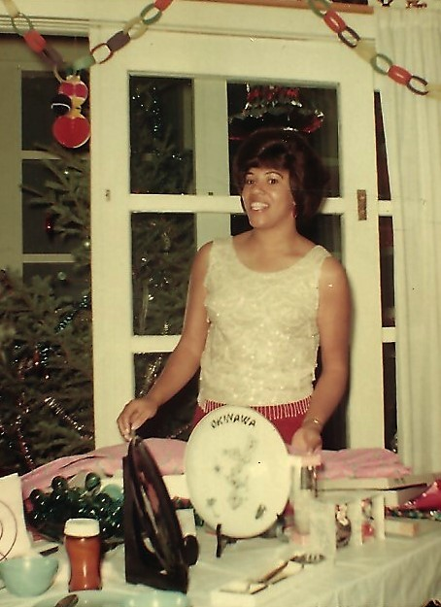
Notes:
So the second time the family were stationed to Okinawa, Japan and left with her last and greatest bundle of joy…

Slide 16

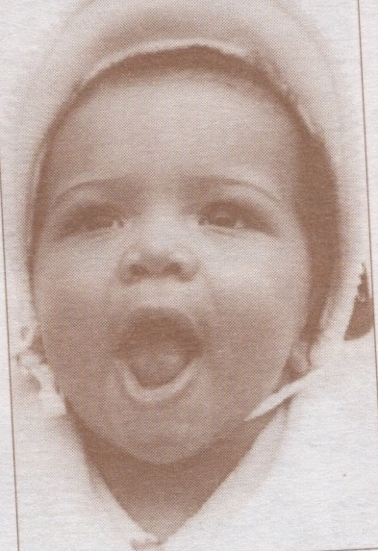
Notes:
Teresa Yvonne. And just as this baby picture implies, Teresa Yvonne came into this world ready to talk nonstop, earning her the nickname, Tweety Bird. Fast forward to April 13th, 1991 and Velma Mae officially became known as “Nana” with the birth of her first grandchild,

Slide 17
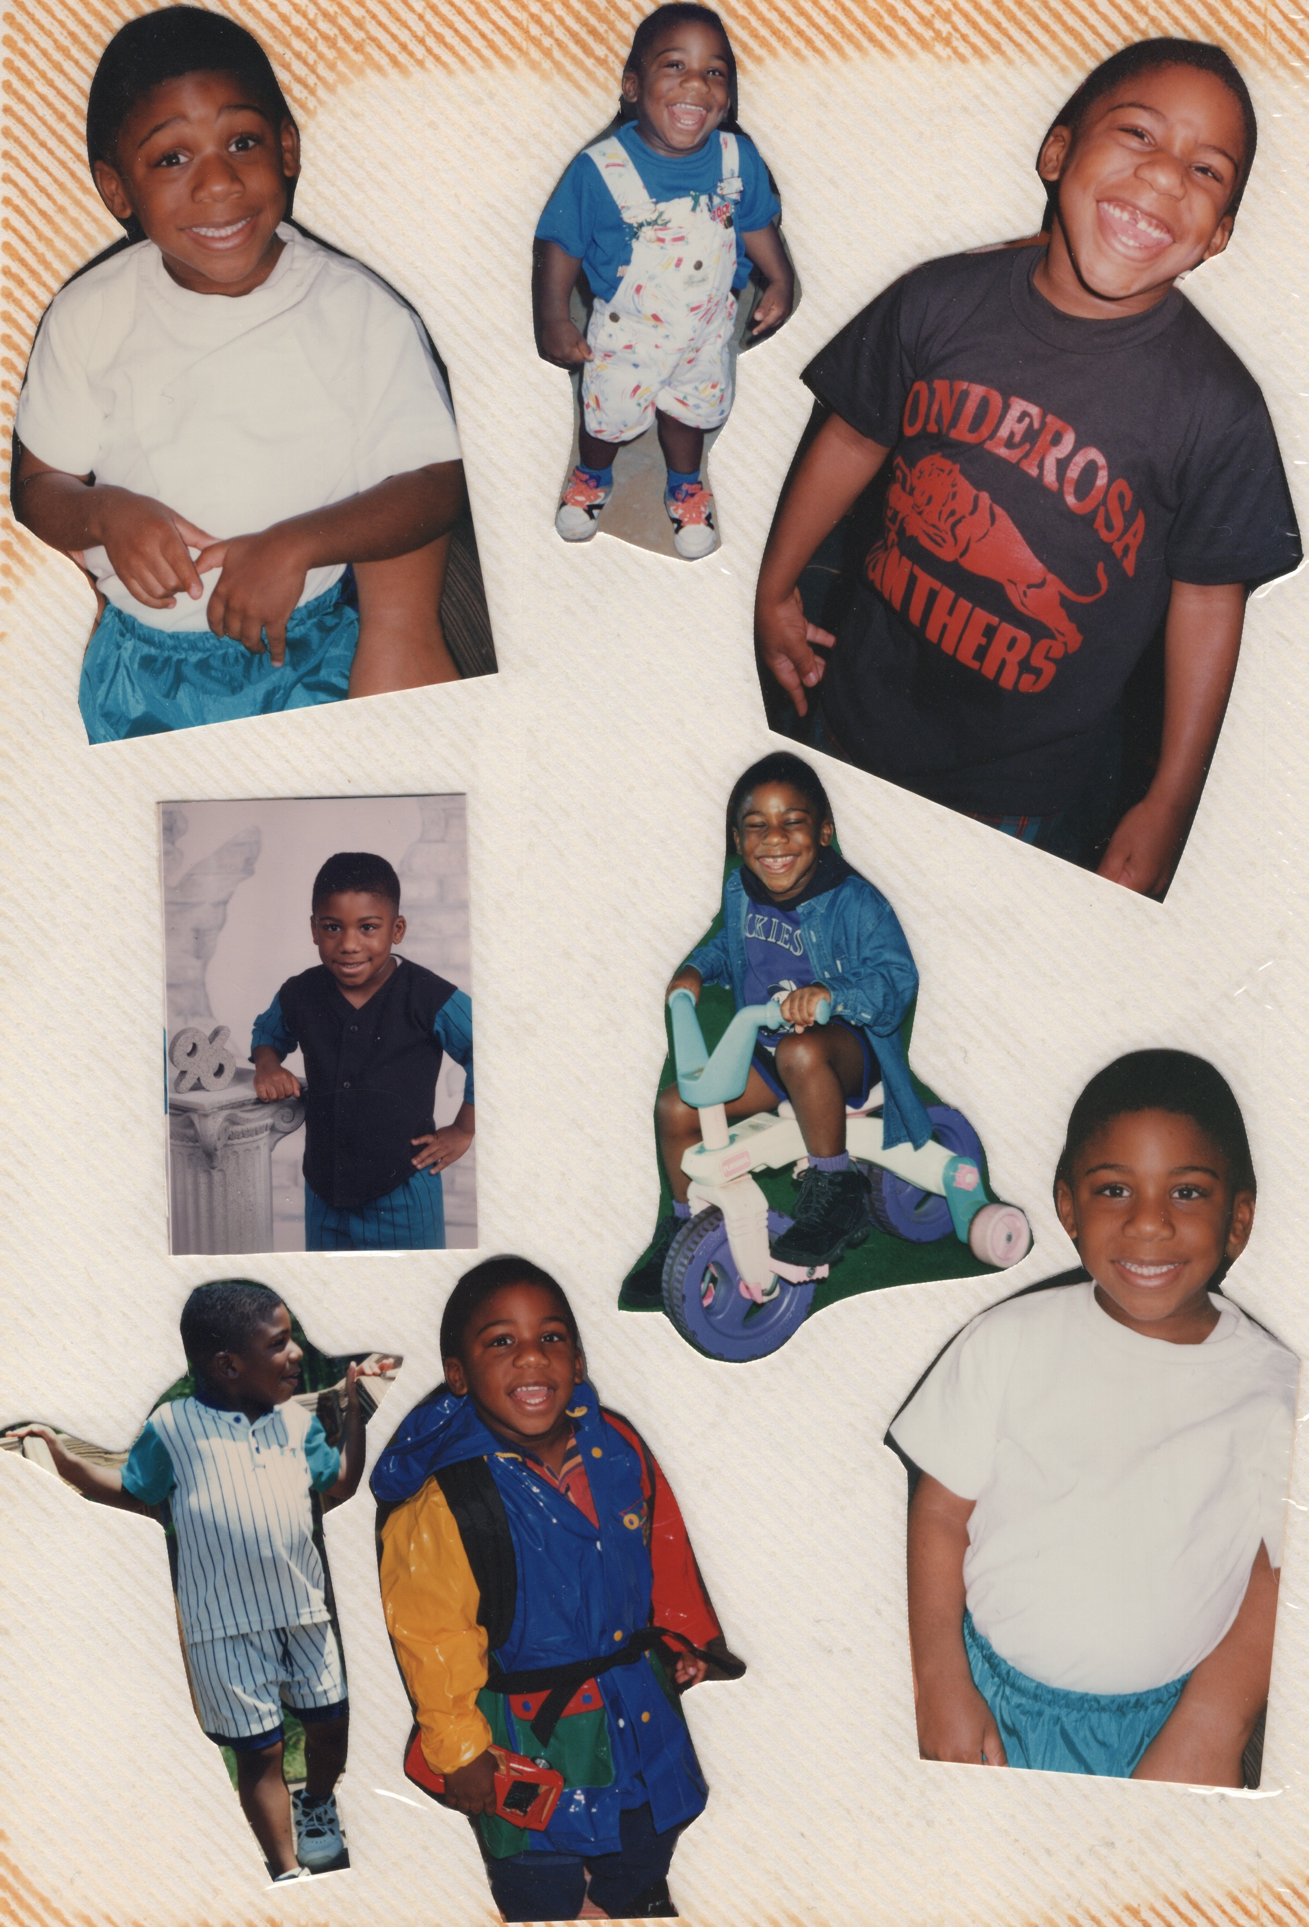
Notes:
Alec Ayers Roberson, who knew how to identify cars as soon as he could talk. Then, on April 22nd, 1997, Nana was blessed with her second grandchild

Slide 18
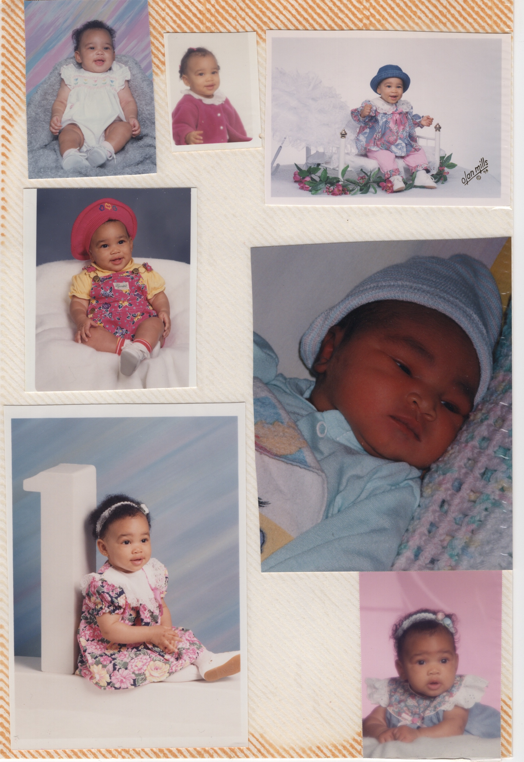
Notes:
Jasmine Renee, who burst into the world with such curiosity, that she grew up to study science. Then, Nana was blessed with her third grandchild on February 4th, 1999

Slide 19
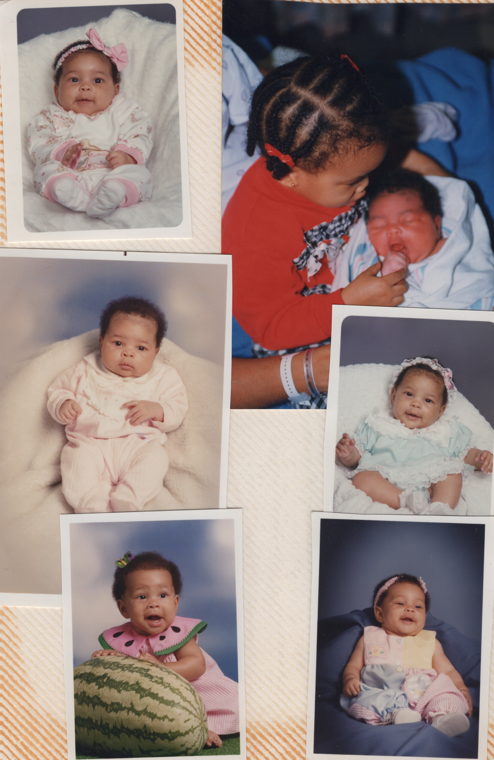
Notes:
Maya Danielle, who loved growing plants as a child, eventually embraced a plant-based diet and became a vegan as a young woman. Finally, Nana was blessed with her fourth and final grandchild on August 29th, 2000

Slide 20

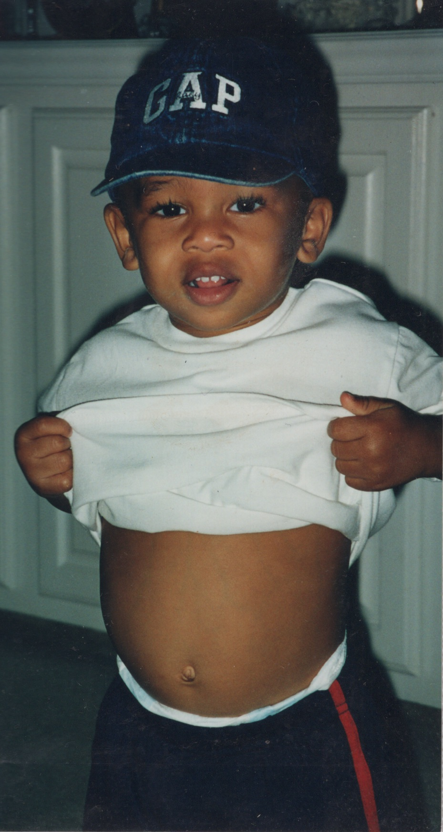
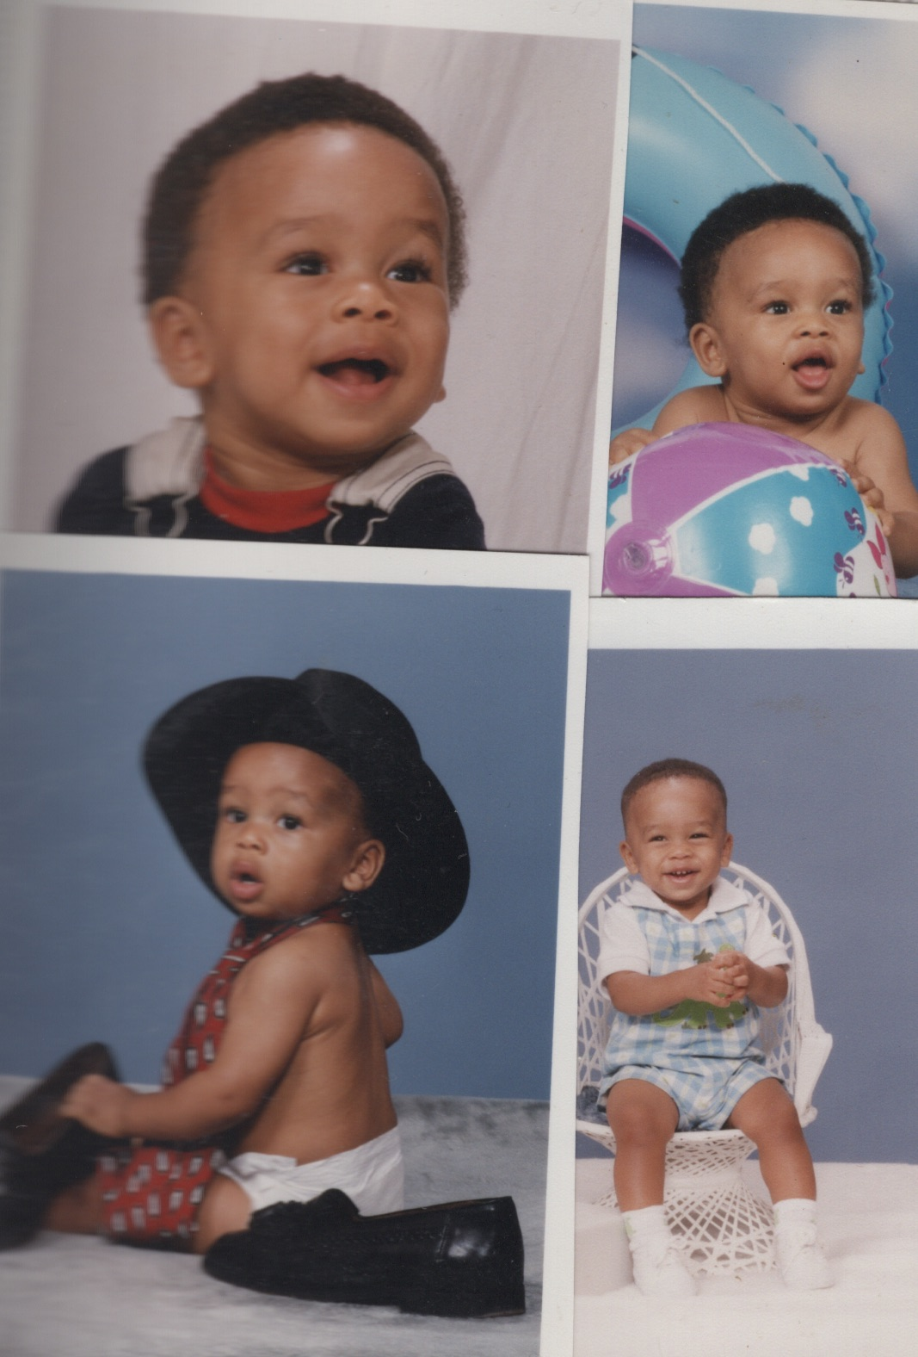
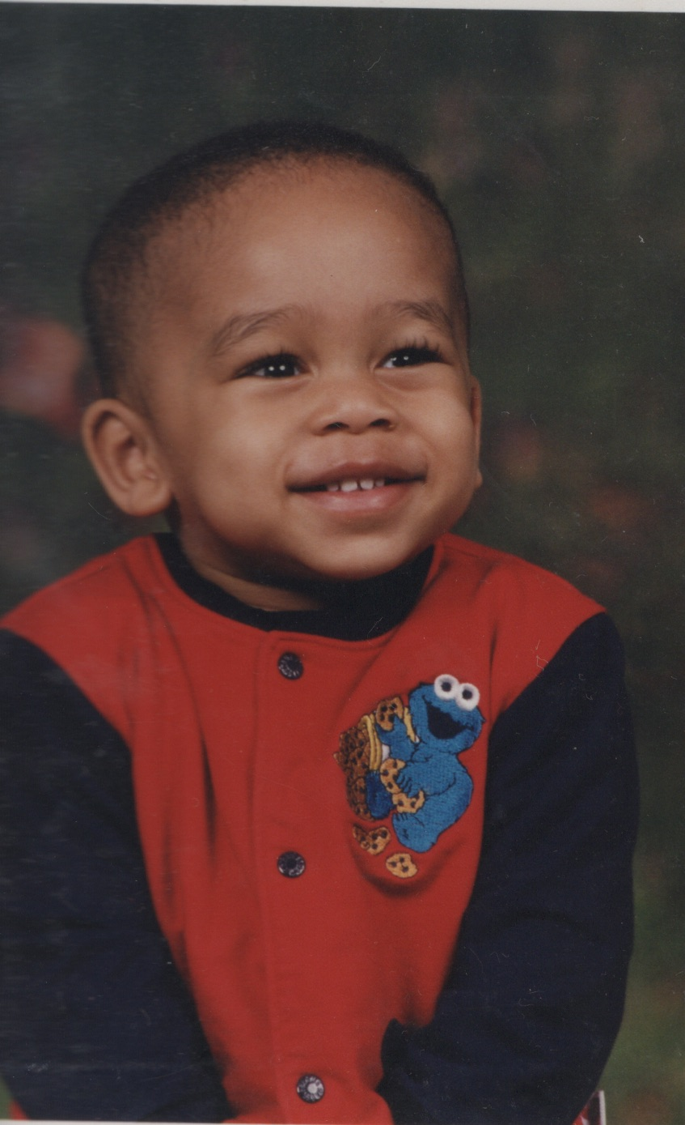
Notes:
CJ!. It’s been a long time since we’ve seen him without a mohawk, right?

Slide 21
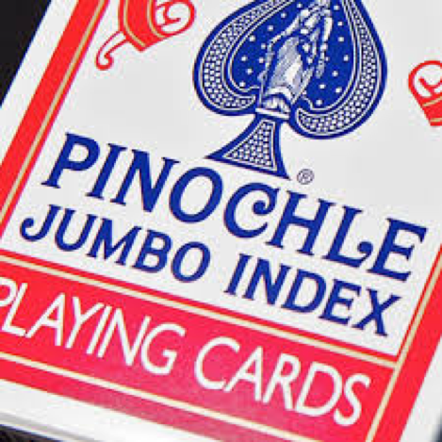
Notes:
When not busying herself with running errands and the lives of her loved ones, Velma Mae enjoys playing pinochle,

Slide 22

Notes:
Hunting for bargains,

Slide 23
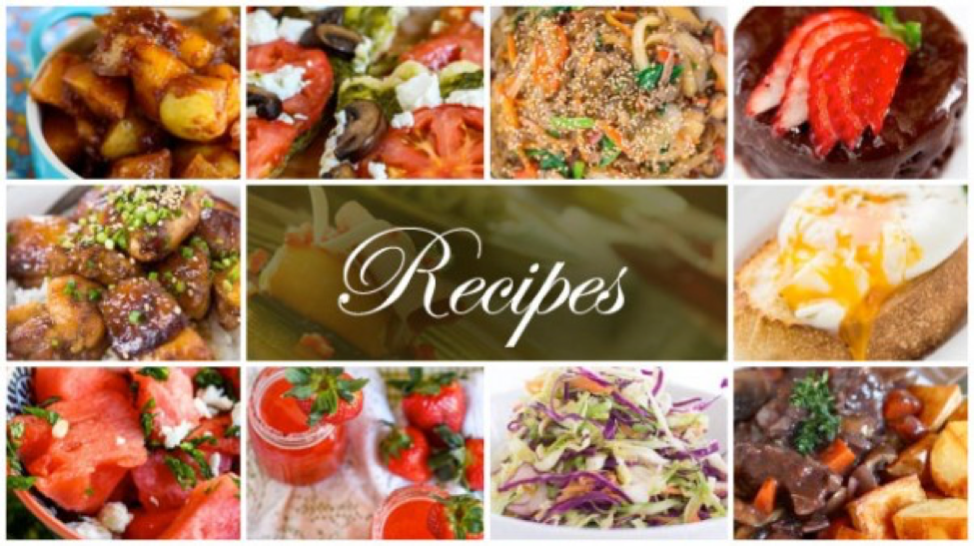
Notes:
Trying out new recipes

Slide 24

Notes:
Exercising, especially riding a bke, except she normally rides a stationary reclining bike

Slide 25

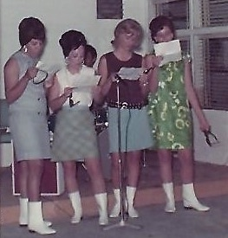
Notes:
And let’s not forget about how much she loves dancing! BTW, Velma Mae is the one on the left. I didn’t have an actual clip of her dancing in her younger days, but here’s a close approximation

Slide 26
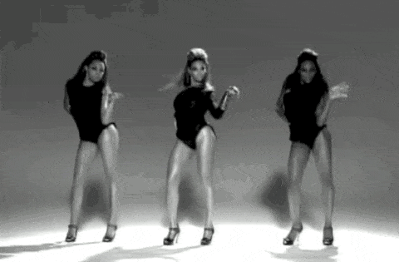
Notes:
Bet you didn’t know Velma Mae was Beyonce’s dancing inspiration! You’ll get to see the real deal as we celebrate.

Slide 27


Slide 28
Music credits:
“Good Times” FreeStockMusic.com
“Concerto for Cootie” Duke Ellington/MP3-Red
“Happy Birthday Velma” 1HappyBirthday.com

